Slide 1


A Purposeful Walk Down Wallstreet
Michael Shields, Nabeel Asghar, Shojib Miah, Michael Chen

Slide 2

Purpose
Provides essential information for developers
Clearly defines architecture
Assists future developers in understanding the design
Defines and informs developers of use cases
2

Slide 3
Assumptions
Internet connection
Tableau installed
Familiar with data
Proper Configuration

Slide 4
Constraints
Agnostic Platform for Financial Instruments
Data integrity
Comprehensive data visualization

Slide 5
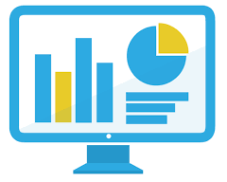



Hardware Architecture
Local machine
Database server (MySQL)
External data source (YAHOO)
Tableau
User
Computer
Database
Notes:
The end-user will interact with the Tableau dashboard that displays all the required information. Developers will interact with the Python classes in PyCharm or any other text editor and run the main file (DataMain.py) which will pull the most up-to-date data. This information is handled by the application before it is stored on the database server. In turn, Tableau will fetch the information from the database and display it for the user.

Slide 6







Software Architecture
User Interface Layer
Dashboard
Service Layer
DataForecast.py EngineeredFeatures.py
DataMain.py DataForecast.py dbEngine.py
Data Access Layer
Database Layer
MySQL SQL Server DataFetch.py
Notes:
This UI provides a detailed analysis of multiple trading algorithms and strategies. These algorithms and strategies will be acting on the GM stock, CARZ index, and other stocks as well as various macroeconomic variables such as unemployment rate and inflation rate among other variables. The middle layer of Python provides the logic, which includes buy/sell signaling, algorithm-based predictions, back testing algorithms and any other manipulation to the incoming stock/macroeconomic variable data statistics. MySQL will further manipulate the data as it is sent from Python, through SQL Stored Procedures.

Slide 7

Security Architecture
Approved to use computer with application installed
Database
Tableau
Enter login details
User
Computer
Notes:
Application security is not a direct operational responsibility because its only accessible on the machine that has all the required Software installed, scripts loaded, and proper admin privileges given. Security will not be a responsibility of the developers.

Slide 8
Communication Architecture
Based on internet connection and database connection
Internet connection to pull data from YAHOO trader and Quandl
Database necessary to store 3 years worth of data
Notes:
The internet connection is necessary to pull the latest data from YAHOO trader via Pandas API, Quandl and bt python dependencies. Within this database there is storing and displaying of the data.

Slide 9
Performance
Tableau info not updated till scripts run by user
Database requires enough storage to support application
Once main file is run, Tableau displays forecasts & calculation of
outlined instruments and variables
Notes:
The speed of execution within Python will depend heavily on the connection to the internet and database connection, however, under normal circumstances a complete execution will take less than one minute. Since the historical data tables are replaced daily, the storage requirements will remain mostly static after the first execution for that day.

Slide 10
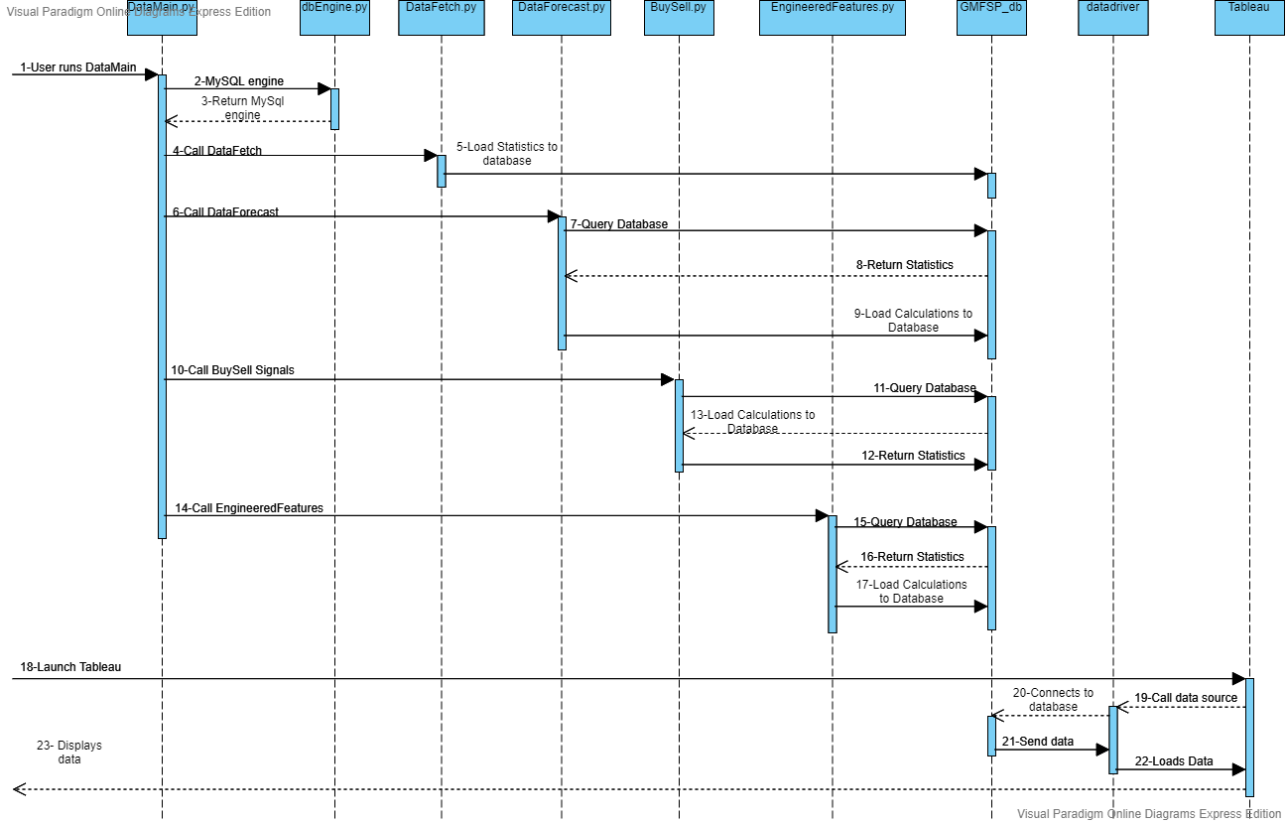
Sequence Diagram
DataMain.py
Notes:
The speed of execution within Python will depend heavily on the connection to the internet and database connection, however, under normal circumstances a complete execution will take less than one minute. Since the historical data tables are replaced daily, the storage requirements will remain mostly static after the first execution for that day.

Slide 11
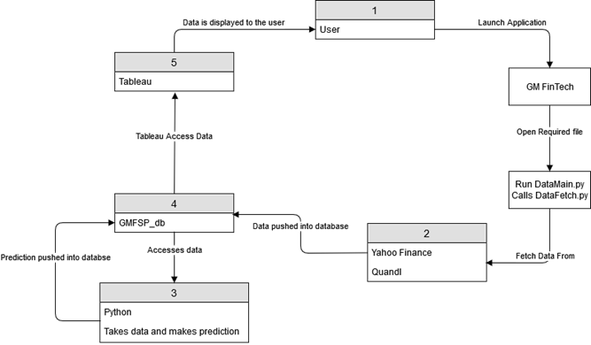
Data Flow Diagram
Notes:
The speed of execution within Python will depend heavily on the connection to the internet and database connection, however, under normal circumstances a complete execution will take less than one minute. Since the historical data tables are replaced daily, the storage requirements will remain mostly static after the first execution for that day.

Slide 12
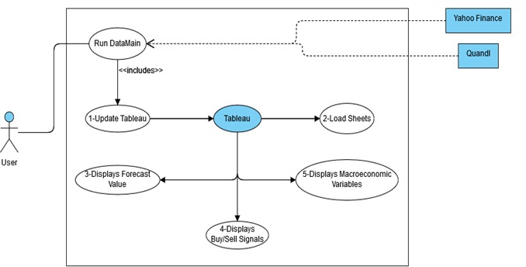
Use Case Diagram
Notes:
The speed of execution within Python will depend heavily on the connection to the internet and database connection, however, under normal circumstances a complete execution will take less than one minute. Since the historical data tables are replaced daily, the storage requirements will remain mostly static after the first execution for that day.

Slide 13
Use Cases
UC-1.0: Update Tableau data source to have the latest data every launch
Actors: | Application User
Description: | In order to get the most accurate and up-to-date data, results, and predications, we must run the Python application every time we launch the application. This is to ensure that outdated numbers do not populate the database and are displayed through Tableau.
Trigger: | This refresh of data must be done every time the application is opened if it was not already done that day.
Preconditions: | The user must have Tableau running. The user must have all the dependencies installed.
Postconditions: | The rest of the application will have the latest data and latest results.
Normal Flow: | Run DataMain.py located in FinsterTab/F2019. Open the Tableau application in the Tableau folder called: “GM_FinTech_Application.twb.” Check if the data-values in any sheet at the bottom is the most recent trading day.
Alternative Flow: | Open the Tableau application in the Tableau folder called: “GM_FinTech_Application.twb.” Check if the data-values in any sheet at the bottom is the most recent trading day. If not, continue to step 3. Run DataMain.py located in FinsterTab/F2019. Check Tableau again to make sure the dates are up to date.
Exceptions: | There is no need to do this refresh of data if it was already done that day or the closest trading day.

Slide 14
Use Cases (cont.)
UC-2.0: All Tableau’s sheets load
Actors: | Application User
Description: | For every sheet (page) and graph, Tableau should load the sheet. For every sheet, an SQL query is executed to find all the data points that will be plotted onto the graphs. There should be no blank sheets or sheets that do not display due to any error.
Trigger: | This is done every time a user clicks a different sheet. There are multiple sheets showing everything from portfolio value to algorithm forecasts.
Preconditions: | The user must have the application running with all its dependencies and libraries it requires. The user must have Tableau running. UC-1.0.
Postconditions: | The application has every sheet displaying data.
Normal Flow: | Open the Tableau application in the Tableau folder called: “GM_FinTech_Application.twb.” Check every sheet to make sure that are not blank canvases.
Alternative Flow: | Open the Tableau application in the Tableau folder called: “GM_FinTech_Application.twb.” Check the sheets to make sure they all display graphs and all work, if any do not work, go to step 3. Return to UC-1 to refresh the database by rerunning DataMain.py.
Exceptions: | There should be no exceptions, all sheets should be working 100% of the time.

Slide 15
Use Cases (cont.)
UC-3.0: Tableau displays forecasted values
Actors: | Application User
Description: | Tableau should show values for its forecast algorithms. There should be no huge outlier in the forecast prices, the stock prices, or the portfolio values.
Trigger: | This checking should be done anytime a user is looking for predicted prices or trends for any day for the stocks that we have stored.
Preconditions: | The user must have the application running with all its dependencies and libraries it requires. The user must have Tableau running. UC-1.0. UC-2.0.
Postconditions: | The application will show the forecasted values that were calculated using our code.
Normal Flow: | Open the Tableau application in the Tableau folder called: “GM_FinTech_Application.twb.” Check if the forecasted algorithms by selecting the sheets at the bottom, each forecasted algorithm should show the forecasted prices.
Alternative Flow: | Open the Tableau application in the Tableau folder called: “GM_FinTech_Application.twb.” Check the forecasted algorithm sheets and see if they are all showing a forecasted price. If not, go to step 3. Return to UC-1 to refresh the database by rerunning DataMain.py.
Exceptions: | There should be no exception, the forecast algorithms should always be working.

